Slide 1


Analysis Of Sales For
Chips Snack
1
Classification: Private

Slide 2
Our 17 year history assures best practice in privacy, security and the ethical use of data
We all have a responsibility to use data for good
Privacy
Security
Ethical use of data
Applies to all facets of our work, from the initiatives we take on, the information we use and how our solutions impact individuals, organisations and society.
We have built our business based on privacy by design principles for the past 17 years
Quantium has strict protocols around the receipt and storage of personal information
All information is de-identified using an irreversible tokenisation process with no ability to
re-identify individuals
We are ISO27001 certified - internationally recognised for our ability to uphold best practice standards across information security
We use ‘bank grade’ security to store and process our data
Comply with 200+ security requirements from NAB, Woolworths and other data partners
All partner data is held in separate restricted environments
All access to partner data is limited to essential staff only
Security environment and processes regularly audited by our data partners
Quantium believes in using data for progress, with great care and responsibility. As such please respect the commercial in confidence nature of this document.
Classification: Private

Slide 3



We are proudly ISO27001 Certified
An international recognition that security is core to how we operate
What this means for our clients and partners
Best practice data governance
Greater assurance for stakeholders through robust risk management and security procedures
Our processes have been tested and proven
Classification: Private

Slide 4
Executive summary
01
The number of chips transactions dramatically increases prior to Christmas. Thus, added visibility to customers via a promotional display or Gondola end would increase purchases driving sales growth over this holiday period.
Mainstream Young Singles & Couples are the primary shopper of chips.
Young and Older Families make up 26% of Chips shoppes and on average purchase larger baskets. There is more opportunity for sales with these shoppers.
Chips Category Review
02
Trial Store Analysis
A control store was constructed to reflect the prior performance of the selected trial store.
After implementing the new store layout the performance of the trial store and the control store were compared. The trial store saw significant uplift from the new store layout.

Slide 5
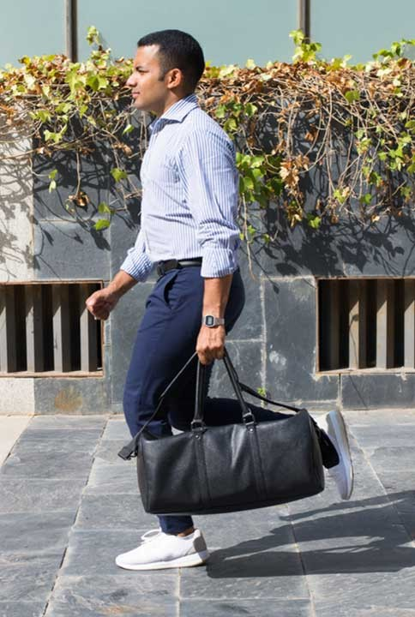
Category

Slide 6
The number of Chips transitions has remained relatively consistent over the last 52wks; a notable increase occurred in the week leading up to Christmas
↺
Snack Food - Chips – Weekly transactions over time
7.0k
6.0k
5.0k
Number of Transactions
4.0k
The total number of transactions in the week including Christmas was negatively affected by public holiday store closures
3.0k
2.0k
1.0k
0.0k
JUL
AUG
SEPT
OC T
NOV
DEC
JAN
FEB
MAR
APR
MAY
JUN
Source: Q.Checkout, 52 weeks to 31 June 2019; Universe: Snack Food - Chips

Slide 7



Affluence appears consistent across each individual life stage profile; Older and Young Family shoppers purchase the highest avg units per transaction
↺
Snack Food - Chips – Average units per transaction by affluence and life stage profile
12
10
9.6
9.8
9.6
9.2
9.2
9.2
Average Units per Transaction
8
6.8
7.1
7.1
7.2
6.3
6.4
6.5
6.3
6.4
6
4.8
5.0
5.1
5.0
4.4
4.4
4
2
0
Young Singles & Couples
Midage Singles & Couples
Older Singels & Couples
New Families
Young Families
Older Families
Retirees
Budget
Mainstream
Premium
Source: Q.Checkout, 52 weeks to 31 June 2019; Universe: Snack Food – Chips

Slide 8



Mainstream Young Singles & Couples make up the largest proportion of Snacking Chips shoppers; Mainstream Retirees also have a significant share
↺
Snack Food - Chips – Proportion of Customers by affluence and life stage profile
Number of Customers
14.4k
7.3k
16.6k
2.5k
9.2k
9.8k
14.8k
100%
17.82%
33.42%
32.51%
23.07%
26.51%
23.24%
26.15%
80%
56.01%
33.31%
29.72%
28.95%
43.76%
Proportion of Customers
45.91%
33.75%
60%
47.81%
40%
33.74%
30.08%
20%
26.17%
43.62%
43.77%
20.67%
0%
Young Singles & Couples
Midage Singles & Couples
Older Singles & Couples
New Families
Young Families
Older Families
Retirees
Budget
Mainstream
Premium
Source: Q.Checkout, 52 weeks to 31 June 2019; Universe: Snack Food – Chips

Slide 9

Trial Store Performance

Slide 10
The control store is constructed to reflect performance of the trial store rather than the average of other stores
↺
Snack Food - Chips – Avg monthly store sales over time
$700
$600
$500
Sales
$400
$300
$200
$100
$0
JUL
AUG
SEP
OC T
NOV
DEC
JAN
FEB
Control Store
Trial Store
Other Stores
Source: Q.Checkout, 52 weeks to 31 June 2019; Universe: Snack Food - Chips

Slide 11
From Feb to May the trial store outperformed the control store highlighting the success of the new store layout
↺
Snack Food – Chips – Number of customers over time
70
60
50
Number of Customers
40
30
20
10
0
JUL
AUG
SEP
OC T
NOV
DEC
JAN
FEB
MAR
APR
MAY
JUN
Control Store
Control Store
5% Confidence Interval
Control Store
95% Confidence Interval
Trial l Store
Source: Q.Checkout, 52 weeks to 31 June 2019; Universe: Snack Food - Chips

Slide 12
Disclaimer: This document comprises, and is the subject of intellectual property (including copyright) and confidentiality rights of one or multiple owners, including The Quantium Group Pty Limited and its affiliates (Quantium) and where applicable, its third-party data owners (Data Providers), together (IP Owners). The information contained in this document may have been prepared using raw data owned by the Data Providers. The Data Providers have not been involved in the analysis of the raw data, the preparation of, or the information contained in the document. The IP Owners do not make any representation (express or implied), nor give any guarantee or warranty in relation to the accuracy, completeness or appropriateness of the raw data, nor the analysis contained in this document. None of the IP Owners will have any liability for any use or disclosure by the recipient of any information contained in, or derived from this document. To the maximum extent permitted by law, the IP Owners expressly disclaim, take no responsibility for and have no liability for the preparation, contents, accuracy or completeness of this document, nor the analysis on which it is based. This document is provided in confidence, may only be used for the purpose provided, and may not be copied, reproduced, distributed, disclosed or made available to a third party in any way except strictly in accordance with the applicable
12
written terms and conditions between you and Quantium, or otherwise with Quantium’s prior written permission

